Slide 1




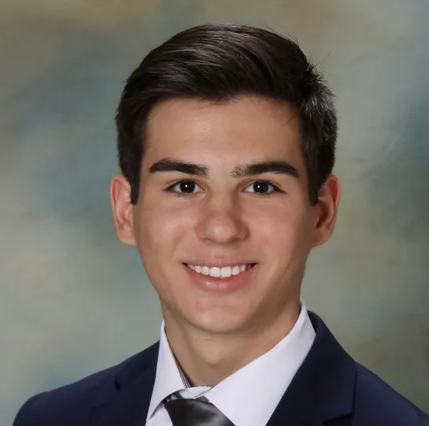

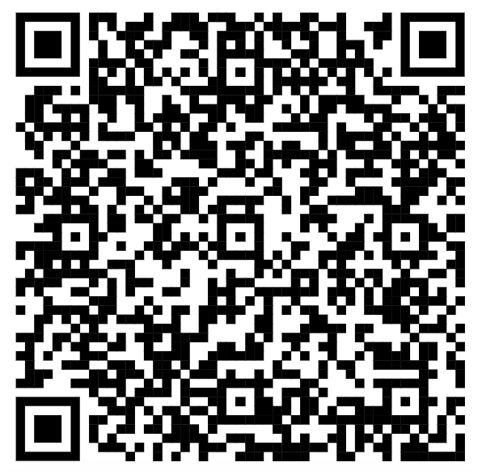
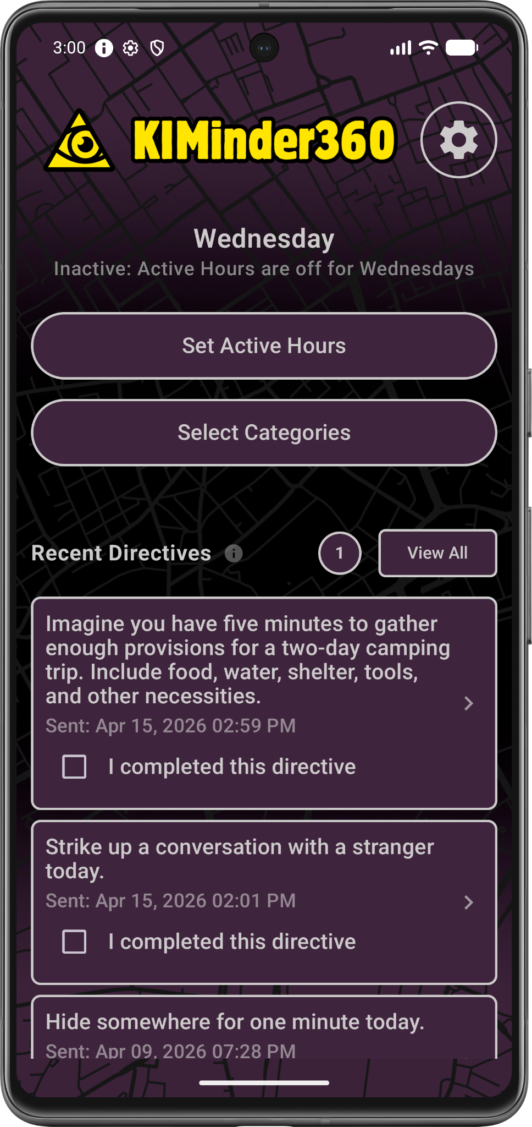
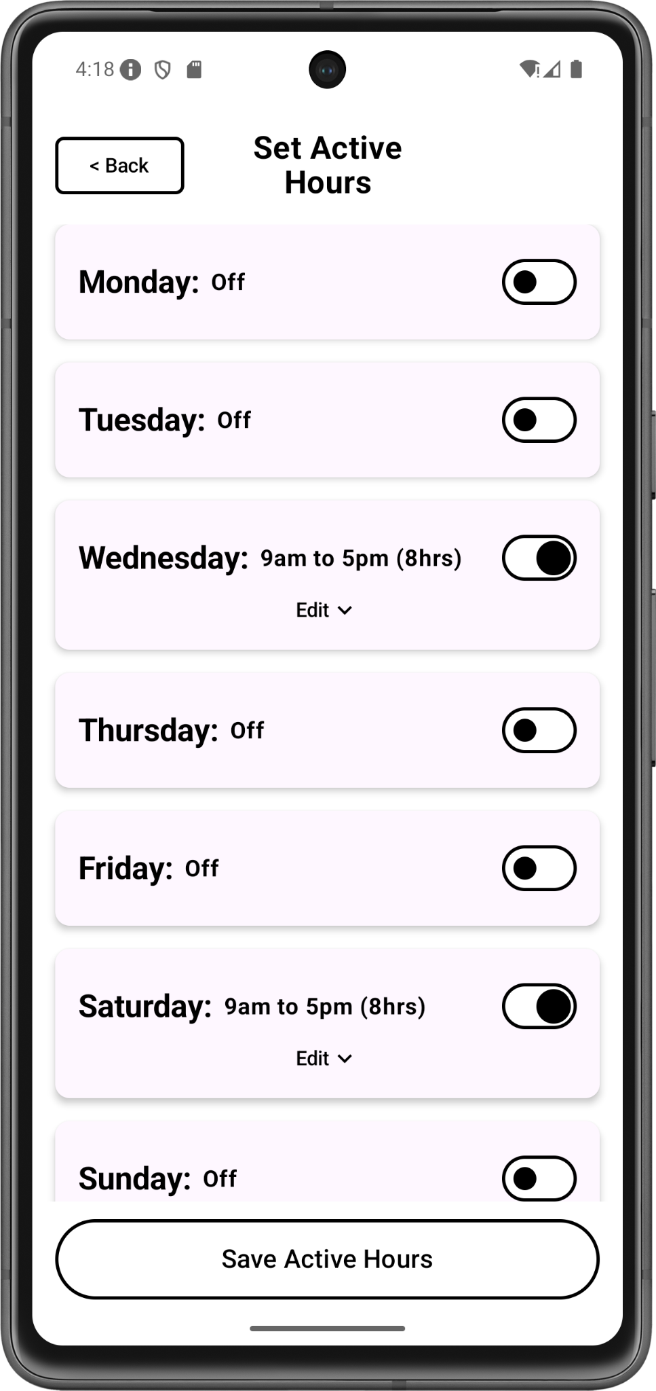
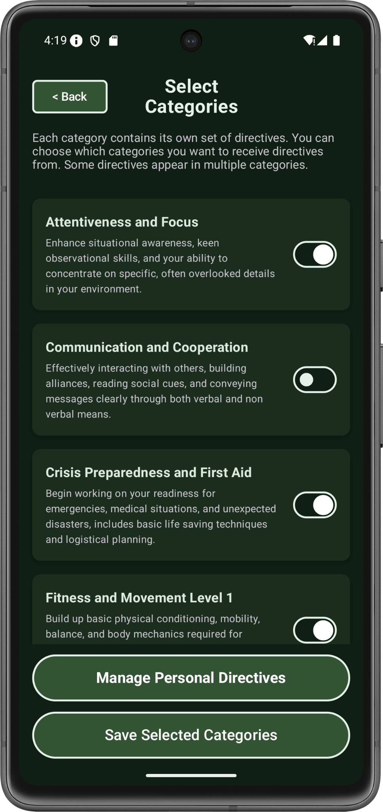
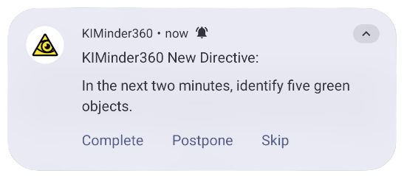
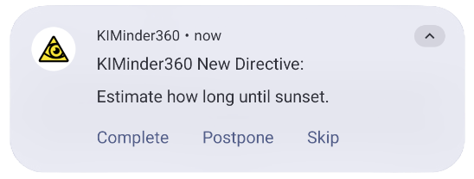




KIMinder360 Mobile App
Automated Situational
Awareness Training
Client: Morgan Boatman,
Winter Communication, LLC
Team Mentor: Md Nazmul Hossain
Spring 2026
Dylan Hyer
Team Lead
Nyle Huntley
Release Manager
Cole Bishop
Lead Editor
Mayanna John
Architect
Visit Our Website
Background
Situational Awareness Will Save Your Life!
Key Features
Keen attentiveness to your immediate surroundings, or situational awareness, is the single most important factor to your survival.
Modern distractions like smartphones dull your situational awareness skills.
There are currently no systematic, reliable, or engaging methods that exist for teaching or honing this critical skill.
Push notifications
Randomized directives and timings
User-defined “Active Hours”
Flexible directive categories
Problem
Our client’s original KIMinder360 program required manual, time consuming phone calls to deliver directives to clients.
Training was inaccessible and not easily scalable, so the reach was limited.
Clients lacked any customization for training.
App screenshots: home screen, active hours, categories
Technologies & Future Work
Examples of directive push notifications
KIMinder360 was developed with Android Studio.
Future work will include introducing cloud database functionality for new content on Firebase Cloud and bringing the app to iOS using Kotlin Multiplatform.
Solution
Delivers a proven awareness training program in a mobile format.
Automates directive delivery for consistent and convenient use.
Helps build lasting awareness habits over time.
Transforms the phone into a tool that keeps awareness training front and center.
Outcomes
Before | After
Training process managed manually | Automated training process
Limited outreach | Broader outreach

